Slide 1
The Bus Driver Problem
Uva11389
Time: 1 seconds

Slide 2
Problem Descriptions(1/2)
In a city there are n bus drivers. Also there are n morning bus routes & n afternoon bus routes with various lengths.
Each driver is assigned one morning route & one evening route.
For any driver, if his total route length for a day exceeds d, he has to be paid overtime for every hour after the first d hours at a flat r taka / hour.

Slide 3
Problem Descriptions(2/2)
Your task is to assign one morning route & one evening route to each bus driver so that the total overtime amount that the authority has to pay is minimized.

Slide 4
Input
The first line of each test case has three integers n, d and r, as described above.
n: n drivers and n routings.
d: total length cannot be exceeded.
r: extra paid r / hour while exceeding length d.
In the second line, there are n space separated integers which are the lengths of the morning routes given in meters.
Similarly the third line has n space separated integers denoting the evening route lengths.
The lengths are positive integers less than or equal to 10000.
The end of input is denoted by a case with three 0 s.

Slide 5
Output
For each test case, print the minimum possible overtime amount that the authority must pay.

Slide 6
Sample Input / Output
Input
2 20 5
10 15
10 15
2 20 5
10 10
10 10
0 0 0
Output
50
0
End of input

Slide 7
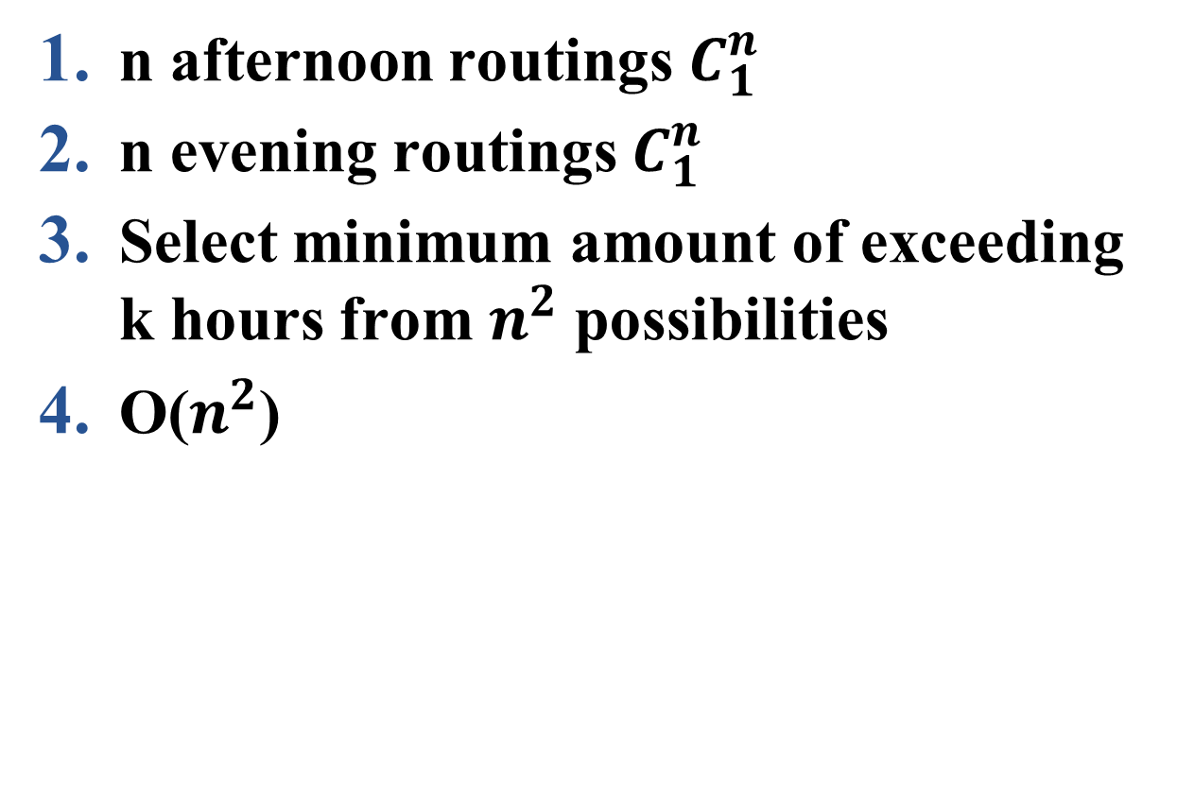
Brute Force
n afternoon routings $C_{1}^{n}$
n evening routings $C_{1}^{n}$
Select minimum amount of exceeding k hours from $n^{2}$ possibilities
O($n^{2}$)

Slide 8
Greedy
Sorting n afternoon routings
Sorting n evening routings
Maximum afternoon + Minimum evening routing
O(nlogn+n)
O(nlogn)

Slide 9
